Slide 1

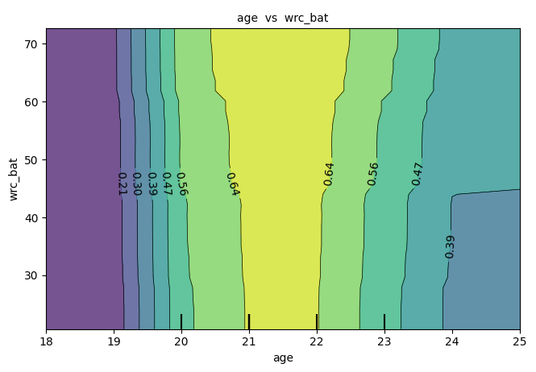
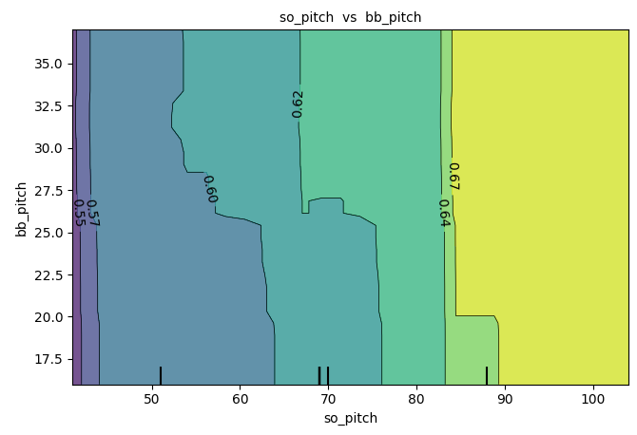
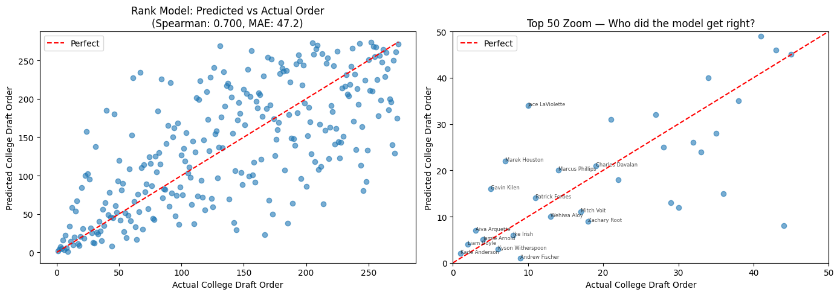
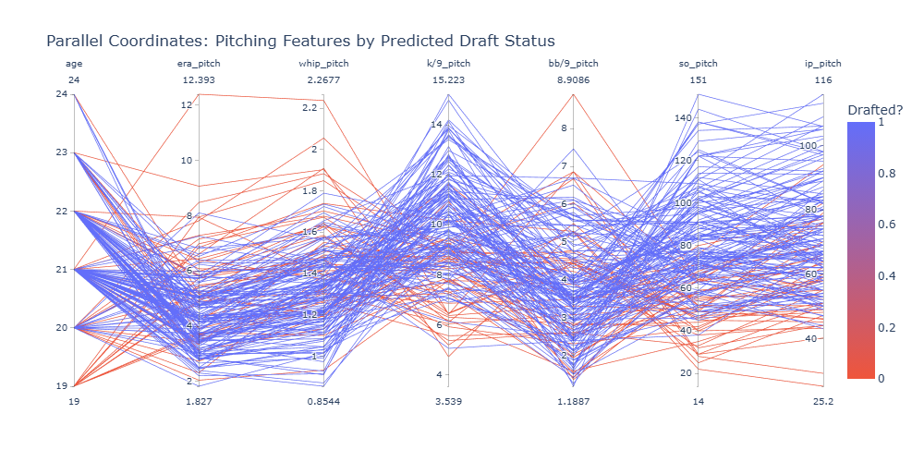
Predicting MLB Draft Outcomes for
NCAA Baseball Players Using XGBoost
Mateo Biggs | Submission ID: 311
Advisor: Prof. Eric Gerber | Khoury College of Computer Sciences, Northeastern University
Introduction & Motivation
Methods
Feature Importance
The MLB Draft (~600 picks, 20 rounds) determines which amateur players go professional. Draft likelihood is critical for college athletes deciding whether to enter the professional leagues or return to school.
This work contributes:
1. An XGBoost draft classifier (88.2% accuracy)
2. A college draft order regressor (ρ = 0.700)
3. A signing bonus predictor (ρ = 0.734)
Three-Stage XGBoost Pipeline:
Stage 1 — Draft Probability Classifier
Binary classification on balanced data (undersampled to 1,438 per class). 80/20 stratified split.
Stage 2 — College Draft Order Regressor
Ranks among college players only. Leave-one-year-out evaluation (train 2021–2024, test 2025).
Stage 3 — Signing Bonus Regressor
Log-transformed target with early stopping on validation MAE.
Age dominates all three models. Batting metrics (wRC, H, SLG, R) and strikeout ability (SO) are strong secondary predictors. Team context (conf. RPI, conf. Rank) confirms scouts evaluate relative to competition.
Data Collection & Features
Data Source: ncaa_bbstats open-source Python package aggregating NCAA Stats, FanGraphs, and MLB Draft data.
Dataset: 16,728 player-seasons (1,438 drafted — 8.6%). Restricted to 2021–2025 to avoid equipment-era confounds and post-Covid changes.
81 Features:
• 33 player stats (ERA, WHIP, FIP, K%, wRC+, OPS)
• 48 team stats (win%, conf. RPI, Pythagorean expectation)
• Physical attributes (height, weight, handedness), only for drafted
Interaction PDP: Draft Probability
Results
Draft Classifier (Balanced Dataset)
Class | Precision | Recall | F1 | n
Not Drafted | 0.901 | 0.858 | 0.879 | 288
Drafted | 0.864 | 0.906 | 0.885 | 288
Draft Order Regressor (2025 Test)
Comparison | Spearman ρ | MAE
XGBoost Model | 0.700 | 47.2
vs MLB Pipeline* | 0.658 vs 0.841 | 17.3 vs 11.3
Future Work
*98 matched players from MLB Pipeline Top 250
Integrate with Prof. Gerber’s MLB draft → MiLB risks framework
Gather more data in upcoming years to compare trends
In a decade or so, look back and assess model’s accuracy in predicting if a player was under- or over-valued
4. Submit to the Journal of Sports Analytics
Pitching Features by Predicted Draft Status
References
Signing Bonus Regressor (n = 273)
[1] Gerber, Eric (2023). Competing Risks Analysis of MLB Draft Data.
[2] Biggs, M (2025). ncaa_bbstats Python package (1. 1. 0). Zenodo.
[3] Zhao, W., Akella, V. S., Yang, S., & Luo, X. (2025). Machine Learning in Baseball Analytics: Sabermetrics and Beyond. Information.
[4] Penn, Matthew (2023). The Value of Playing in College Baseball to Major League Baseball Organizations. Renée Crown University Honors Thesis Projects.
[5] Seneker, Derek (2025). Maximizing the MLB Draft: How College Performance and Leverage Impact Polayer Signing Bonus and Team Payoff. CMC Senior Theses.
$370K*
0.448
0.734
Mean Absolute
Error
R² Score
Spearman
Correlation
*Signing bonus range: $1,000 - $9,250,000
RISE 2026 • Northeastern University • Khoury College of Computer Sciences

